Slide 1
Chapter 3: Information Representation
Floating Point Numbers
Notes:
This presentation will expand on what we have learned about integer representation and apply it to floating point numbers.

Slide 2
Floating-Point Representation
Signed magnitude, One’s complement & Two’s complement
For Integer values only
Scientific & business applications
Need real number values
Floating-point representation solves this problem
Notes:
The signed magnitude, one’s complement, and two’s complement representation that we have just presented deal with integer values only.
Without modification, these formats are not useful in scientific or business applications that deal with real number values.
Floating-point representation solves this problem.

Slide 3
Floating-Point Representation
Floating-point emulation
Perform floating-point calculations using any integer format
Programs make it seem as if floating-point values are being used
Today’s computers have specialized hardware that performs floating-point arithmetic with no special programming required
Notes:
If we are clever programmers, we can perform floating-point calculations using any integer format.
This is called floating-point emulation, because floating point values aren’t stored as such, we just create programs that make it seem as if floating-point values are being used.
Most of today’s computers are equipped with specialized hardware that performs floating-point arithmetic with no special programming required.

Slide 4
Floating-Point Representation
Floating-point numbers allow an arbitrary number of decimal places to the right of the decimal point
For example: 0.5 × 0.25 = 0.125
Scientific notation often used
For example:
0.125 = 1.25 × 10⁻¹
5,000,000 = 5.0 × 10⁶
Notes:
Floating-point numbers allow an arbitrary number of decimal places to the right of the decimal point.
For example: 0.5 × 0.25 = 0.125
They are often expressed in scientific notation.
Two examples are shown here:
0.125 = 1.25 × 10⁻¹
5,000,000 = 5.0 × 10⁶

Slide 5
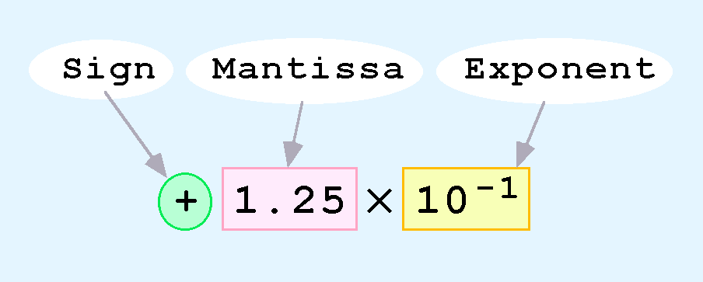
Floating-Point Representation
Computers use a form of scientific notation for floating-point representation
Numbers written in scientific notation have three components:
Notes:
Computers use a form of scientific notation for floating-point representation
Numbers written in scientific notation have three components: the sign, the mantissa, and the exponent.

Slide 6
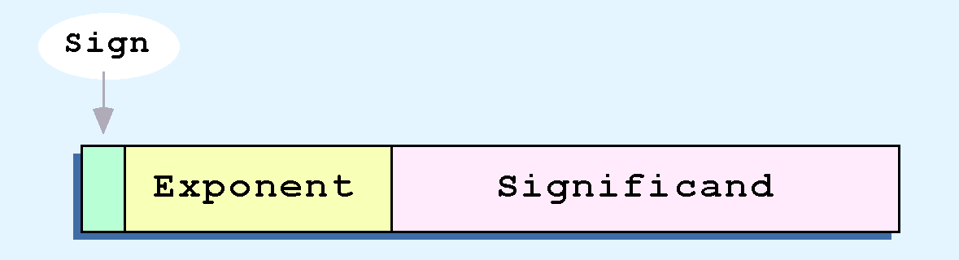
Floating-Point Representation
Components have three fixed-size fields:
One-bit sign field - sign of the stored number
Size of the exponent field - range of numbers
Size of the significand - precision of the number
Notes:
These components have three fixed-sized fields.
The one-bit sign field is the sign of the stored number.
The size of the exponent field, determines the range or size of numbers that can be represented.
The size of the significand determines the precision or number of significant digits of the number.

Slide 7
Floating-Point Representation
IEEE-754 single precision floating point standard
8-bit exponent
23-bit significand
IEEE-754 double precision floating point standard
11-bit exponent
52-bit significand
For illustrative purposes, we will use a 14-bit model with a 5-bit exponent and an 8-bit significand.
Notes:
The IEEE-754 single precision floating point standard uses an 8-bit exponent and a 23-bit significand.
The IEEE-754 double precision standard uses an 11-bit exponent and a 52-bit significand.
For illustrative purposes, we will use a 14-bit model with a 5-bit exponent and an 8-bit significand.

Slide 8
Floating-Point Representation
Significand of a floating-point number
preceded by an implied binary point
contains a fractional binary value
Exponent
indicates power of 2 to which significand is raised
Notes:
The significand of a floating-point number is always preceded by an implied binary point.
Thus, the significand always contains a fractional binary value.
The exponent indicates the power of 2 to which the significand is raised.

Slide 9
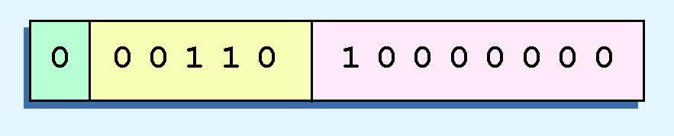
Floating-Point Representation
Example:
Express 32₁₀ in simplified 14-bit floating-point model
Known: 32 is 2⁵
Scientific notation 32 = 1.0 x 2⁵ = 0.1 x 2⁶
Sign is 0 (positive)
Exponent becomes 110 (= 6₁₀)
Significand becomes 1
Notes:
Let’s look at this example:
Express 32₁₀ in the simplified 14-bit floating-point model.
We know that 32 is 2⁵.
So in (binary) scientific notation 32 = 1.0 x 2⁵ = 0.1 x 2⁶.
Using this information, we put 110 (= 6₁₀) in the exponent field and 1 in the significand as shown.

Slide 10
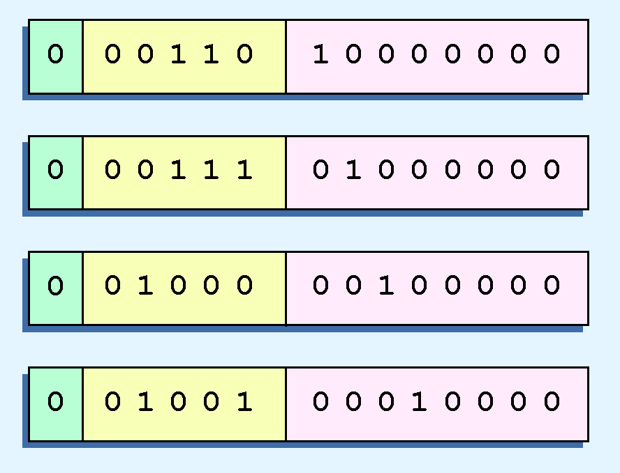
Floating-Point Representation
Illustrations at right
all equivalent representations for 32 using our simplified model
waste space
cause confusion
Notes:
The illustrations shown at the right are all equivalent representations for 32 using our simplified model.
Not only do these synonymous representations waste space, but they can also cause confusion.

Slide 11
Floating-Point Representation
No allowances for negative exponents
no way to express 0.5 (=2 ⁻¹)
These problems can be fixed by adding two rules to our basic model.
Notes:
Another problem with our system is that we have made no allowances for negative exponents.
We have no way to express 0.5 (=2 ⁻¹)!
Notice that there is no sign in the exponent field!
These problems can be fixed with no changes to our basic model, however we will add one more rule.

Slide 12
Floating-Point Representation
New rule: significand must be normalized to have 1 to the left of the binary point
1 is assumed before the binary point
results in a unique pattern for each floating-point number
IEEE-754 standard
1 is assumed before the binary point
Increases precision of the representation by a power of two (Why?)
Notes:
The new rule is that the significand must normalized to have a 1 to the left of the binary point. This results in a unique pattern for each floating-point number.
This one will be implied and is assumed before the binary point.
This is the IEEE-754 standard, it has an implied 1 - meaning that a 1 is assumed before the binary point.
By using an implied 1, we increase the precision of the representation by a power of two. (Do you know why?)
By adding an implied 1 to the beginning of the significand, there is an additional binary column for the number and each column is an additional power of two.

Slide 13
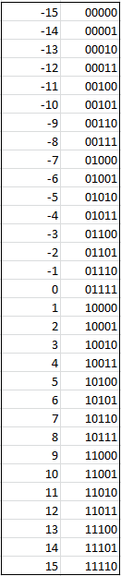
Floating-Point Representation
Biased exponent
Provide negative exponents
Bias is a number that is approximately midway in the range of values expressible by the exponent
Subtract the bias from the value in the exponent to determine its true value
New rule for our model
a 5-bit exponent
use 15 for our bias
excess-15 representation
exponent values less than 15 are negative, representing fractional numbers
Notes:
To provide for negative exponents, we will use a biased exponent.
A bias is a number that is approximately midway in the range of values expressible by the exponent. We subtract the bias from the value in the exponent to determine its true value.
In our case, we have a 5-bit exponent. We will use 15 for our bias. This is called excess-15 representation.
The new rule for our model, exponent values less than 15 are negative, representing fractional numbers. The binary exponents for -15 through 15 are shown on the right.

Slide 14
Floating-Point Representation
Example:
Express 32₁₀ in revised 14-bit floating-point model
Known: 32 = 1.0 x 2⁵
To use excess 15 biased exponent:
Add 15 to 5, giving 20₁₀ (=10100₂)
Graphically:
Hidden 1
Notes:
Example:
Express 32₁₀ in the revised 14-bit floating-point model.
We know that 32 = 1.0 x 2⁵ = 0.1 x 2⁶.
To use our excess 15 biased exponent, we add 15 to 5, giving 20₁₀ (=10100₂).
Graphically:

Slide 15
Floating-Point Representation
Example:
Express 0.0625₁₀ in revised 14-bit floating-point model
Known: 0.0625 is 2⁻⁴
0.0625 = 1.0 x 2⁻⁴
To use excess 15 biased exponent:
Add 15 to -4, giving 11₁₀ (=01011₂)
Graphically:
Hidden 1
Notes:
Let’s look at another example:
Express 0.0625₁₀ in revised 14-bit floating-point model
We know that 0.0625 is 2⁻⁴. So in (binary) scientific notation 0.0625 = 1.0 x 2⁻⁴ = 0.1 x 2 ⁻³.
To use our excess 15 biased exponent, we add 15 to -4, giving 11₁₀ (=01011₂).

Slide 16
Floating-Point Representation
Example:
Express -26.625₁₀ in revised 14-bit floating-point model
Calculate: 26.625₁₀ = 11010.101₂
Normalizing: 26.625₁₀ = 1.1010101 x 2 ⁴
To use our excess 15 biased exponent
add 15 to 4, giving 19₁₀ (=10011₂).
Add 1 in the sign bit
Graphically
Hidden 1
Notes:
Example:
Express -26.625₁₀ in the revised 14-bit floating-point model.
We find 26.625₁₀ = 11010.101₂. Normalizing, we have: 26.625₁₀ = 1.1010101 x 2 ⁴.
To use our excess 15 biased exponent, we add 15 to 4, giving 19₁₀ (=10011₂). We also need a 1 in the sign bit.
1 10100 10101010

Slide 17
Floating-Point Representation
IEEE-754 single precision floating point standard
Bias of 127 over its 8-bit exponent
An exponent of 255 indicates a special value:
If significand is zero = value is ± infinity
If significand is nonzero = value is NaN
“not a number”
IEEE-754 double precision standard
Bias of 1023 over its 11-bit exponent
An exponent of 2047 indicates a special value
Like above…
Notes:
The IEEE-754 single precision floating point standard uses bias of 127 over its 8-bit exponent.
An exponent of 255 indicates a special value.
If the significand is zero, the value is ± infinity.
If the significand is nonzero, the value is NaN, “not a number,” often used to flag an error condition.
The double precision standard has a bias of 1023 over its 11-bit exponent.
The “special” exponent value for a double precision number is 2047, instead of the 255 used by the single precision standard.

Slide 18
Floating-Point Representation
14-bit model and IEEE-754 floating point standard allow two representations for zero
All zeros in exponent and significand
Sign bit can be either 0 or 1
Avoid testing a floating-point value for equality to zero
Negative zero does not equal positive zero.
Notes:
Both the 14-bit model that we have presented and the IEEE-754 floating point standard allow two representations for zero.
Zero is indicated by all zeros in the exponent and the significand, but the sign bit can be either 0 or 1.
This is why programmers should avoid testing a floating-point value for equality to zero.
Negative zero does not equal positive zero.

Slide 19
Floating-Point Representation
Floating-point representation - model must be finite
Limited to a number of bits
Real number system – infinite
Models are an approximation of a real value
Every model breaks down - introducing errors
A greater number of bits in the model reduces errors
Never totally eliminate them
Limited by memory resources
Notes:
No matter how many bits we use in a floating-point representation, our model must be finite.
The real number system is, of course, infinite, so our models can give nothing more than an approximation of a real value.
At some point, every model breaks down, introducing errors into our calculations.
By using a greater number of bits in our model, we can reduce these errors, but we can never totally eliminate them.
Also, a greater number of bits uses greater memory resources.

Slide 20
Floating-Point Representation
Reduce error
- or-
Aware of the possible magnitude of error in calculations
Errors can compound through repetitive arithmetic operations
Example: our 14-bit model cannot exactly represent decimal value 128.5
In binary it is 9 bits wide: 10000000.1₂ = 128.5₁₀
Notes:
Our job becomes one of reducing error, or at least being aware of the possible magnitude of error in our calculations.
We must also be aware that errors can compound through repetitive arithmetic operations.
For example, our 14-bit model cannot exactly represent the decimal value 128.5. In binary, it is 9 bits wide:
10000000.1₂ = 128.5₁₀

Slide 21
Floating-Point Representation
128.5₁₀ in our 14-bit model - lose the low-order bit giving a relative error of:
A procedure that repetitively added 0.5 to 128.5
Error of nearly 2% after only four iterations
^{128.5 - 128}
^{128.5}
^{≈ 0.39%}
Notes:
When we try to express 128.5₁₀ in our 14-bit model, we lose the low-order bit, giving a relative error of about 0.39%
If we had a procedure that repetitively added 0.5 to 128.5, we would have an error of nearly 2% after only four iterations.

Slide 22
Floating-Point Representation
Floating-point errors reduced
Use operands that are similar in magnitude
For problem adding 0.5 to 128.5
Better to iteratively add 0.5 to itself
Then add 128.5 to this sum
Error was caused by loss of the low-order bit
Loss of the high-order bit is more problematic
Notes:
Floating-point errors can be reduced when we use operands that are similar in magnitude.
If we were repetitively adding 0.5 to 128.5, it would have been better to iteratively add 0.5 to itself and then add 128.5 to this sum.
In this example, the error was caused by loss of the low-order bit.
Loss of the high-order bit is more problematic.

Slide 23
Floating-Point Representation
Floating-point overflow and underflow
Cause programs to crash
Overflow
There is no room to store high-order bits resulting from a calculation
Underflow
When a value is too small to store, possibly resulting in division by zero
Experienced programmers know that it’s better for a program to crash than to have it produce incorrect, but plausible, results.
Notes:
Floating-point overflow and underflow can cause programs to crash.
Overflow occurs when there is no room to store the high-order bits resulting from a calculation.
Underflow occurs when a value is too small to store, possibly resulting in division by zero.
Experienced programmers know that it’s better for a program to crash than to have it produce incorrect, but plausible, results.

Slide 24
Floating-Point Representation
Floating-point numbers
Understand the terms range, precision, and accuracy
Range
The difference between the largest and smallest values that it can express
Accuracy
how closely a numeric representation approximates a true value
Precision
indicates how much information we have about a value
significant digits
Notes:
When discussing floating-point numbers, it is important to understand the terms range, precision, and accuracy.
The range of a numeric integer format is the difference between the largest and smallest values that it can express.
Accuracy refers to how closely a numeric representation approximates a true value.
The precision of a number indicates how much information we have about a value.
In science and engineering, this is referred to as the significant digits.

Slide 25
Floating-Point Representation
Many problems with floating point numbers
Usually- Greater precision leads to better accuracy
Not always true
Example, 3.1333 is a value of pi that is accurate to two digits, but has 5 digits of precision
Truncated bits may give different results for commutative or distributive calculations
This means that we cannot assume:
(a + b) + c = a + (b + c) or
a*(b + c) = ab + ac
Notes:
There are many problems with floating point numbers.
Here are two examples:
Most of the time, greater precision leads to better accuracy, but this is not always true.
For example, 3.1333 is a value of pi that is accurate to two digits, but has 5 digits of precision.
Because of truncated bits, you cannot always assume that a particular floating point operation is commutative or distributive.
This means that the result for the left side of these equations may not equal the right side.

Slide 26
Floating-Point Representation
Floating-point calculations at HOL 6 are easy
Hidden problems
Floating-point calculations at Levels 3 &5 are more difficult
Require careful planning and strict models
Floating-point numbers are an approximation
Notes:
Floating-point calculations are easy and something that we take for granted when programming at the HOL6 level.
At Levels 3 & 5, they become more difficult and they require strict models and careful programming to cover all cases.
Hopefully, this presentation helped you see how floating point numbers are just an approximation and can affect out results.

